Slide 1
System and Network Administration
TinyNet Essentials

Slide 2
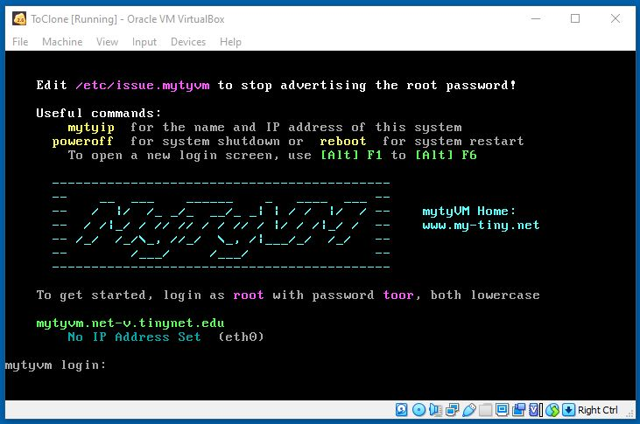
ToClone – No specialized Apps
Click this square icon to get rid of these bars
You will not see anything when you type the password
(to prevent “shoulder surfing”)

Slide 3
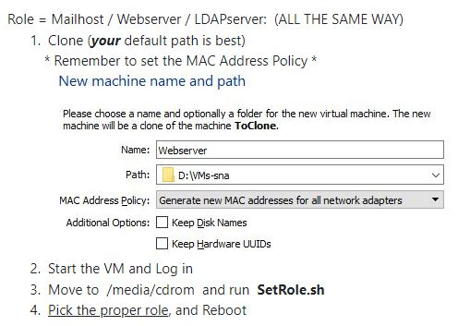
Clone: New MAC Address
Each system on the network MUST have a Unique MAC Address
Duplicate MAC
addresses
GUARANTEE
Unexpected
Results !

Slide 4
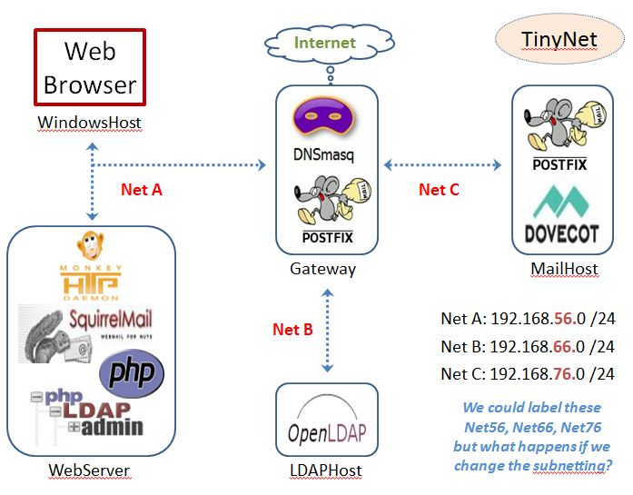
Gateway: One interface for each subnet
HOSTNAME
Is registered
With dnsmasq
Via DHCP
Matched to
Configured
cnames
Broadcast
Domain

Slide 5
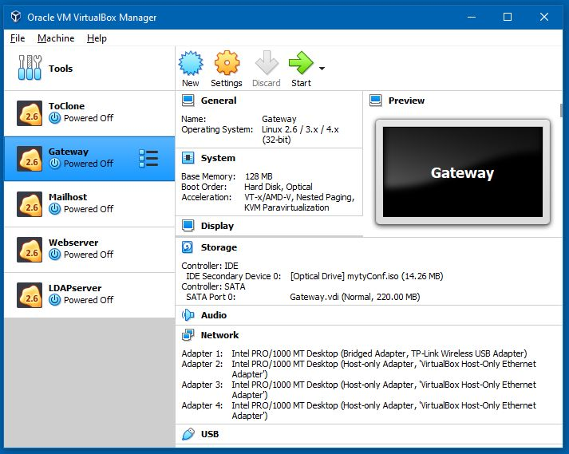
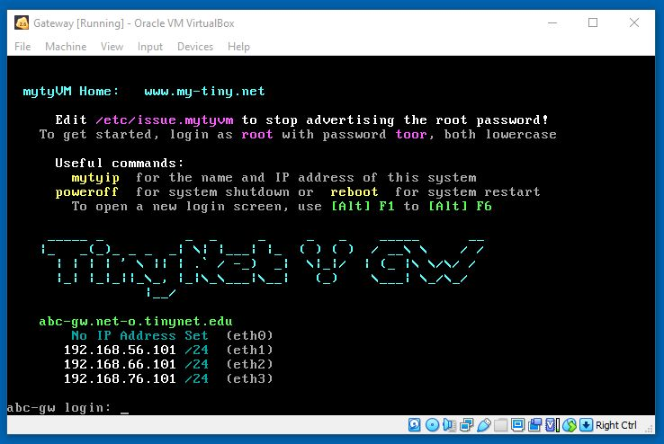
Gateway needs 4 network adapters
1 Bridged
2,3,4 Host-Only
All others have one
Host-Only
Make sure the Gateway is at the login screen before starting the other VMs
(no need to log in)
IP for eth0 on the Gateway depends on your ISP

Slide 6
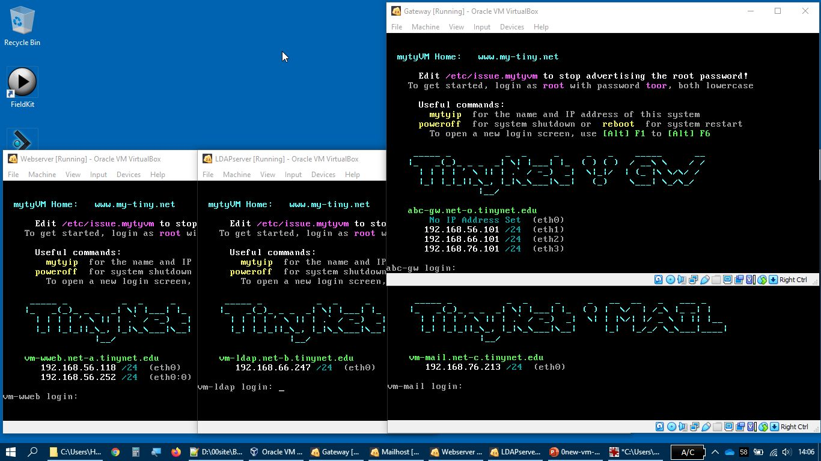
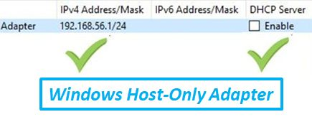
No IP for eth0 on the Gateway is also OK
Web: net-a
ldap: net-b
Mail: net-c
net-a: ..56.+ net-b: ..66.+ net-c: ..76.+
Gateway has an interface for each subnet (net-a, net-b, net-c)
Windows Host-Only adapter and Webserver are on the same subnet

Slide 7
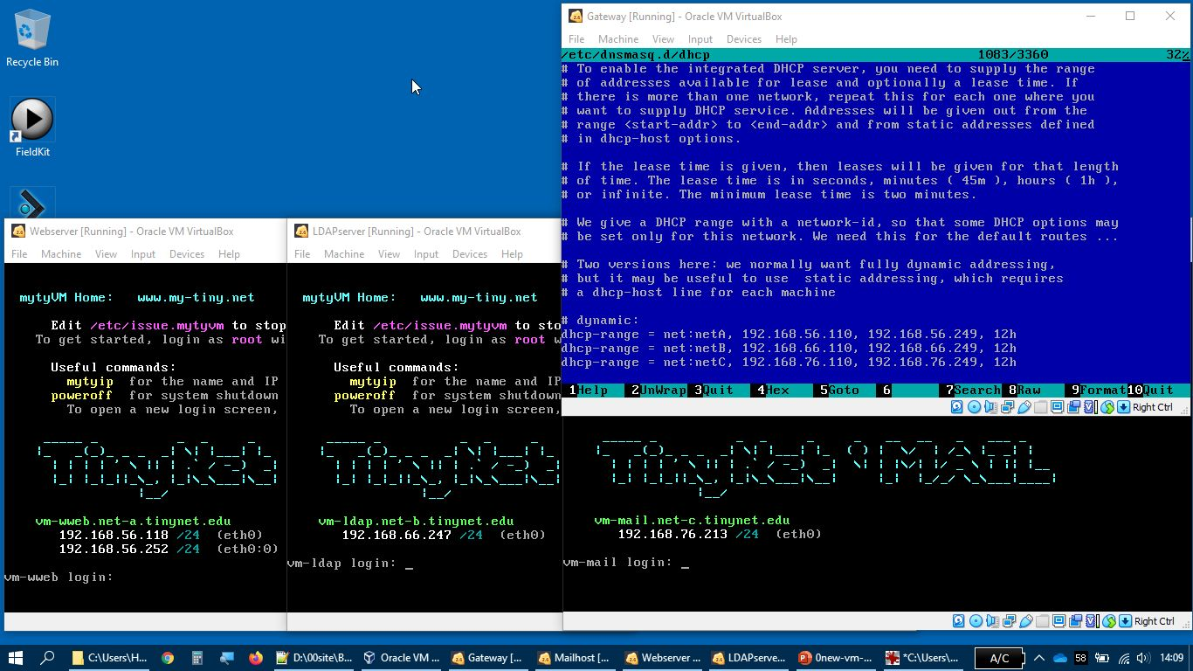
/etc/dnsmasq.d/dhcp
net-a: ..56.+
net-b: ..66.+
net-c: ..76.+
Static address for https://
/etc/rc.d/rc.inet1 processes /etc/HOSTNAME
to put the net into the DCHP discover message

Slide 8
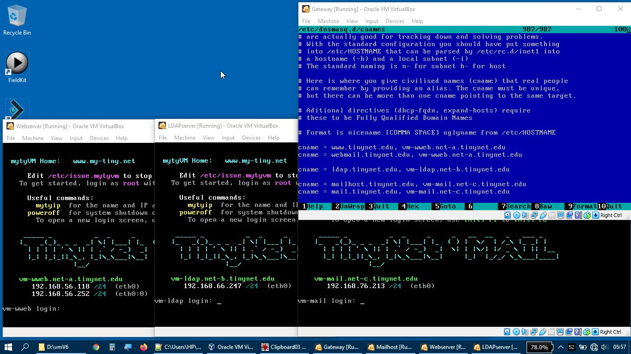
/etc/dnsmasq.d/cnames
cnames allow the DNS to match one IP to several names
Second half of the cnames line must exactly match the HOSTNAME

Slide 9
Troubleshooting the DNS Service
nslookup and dig
Run in debug mode
Restart after updates
Check the logs to familiarise yourself with what it says when it starts
Ensure that the process is running,and listening on UDP (and TCP) port 53 (the domain port)
Requires skills of
Mechanic
Sociologist
Researcher

Slide 10
Check the Comptia Videos by Professor Messer link in Moodle if you need some extra review!

Slide 11




Slide 12
Virtualbox: Bridged interface
VirtualBox connects to one of the installed network interfaces on the host to send and receive
The VM acts like it is physically connected to the network, but there is no new interface visible on the host system
VirtualBox asks your ISP for a new IP address for the VM (which will not be assigned if the network requires a separate login for every connection).
When the Bridged interface has its own IP address, it has full connectivity on the network, and can be contacted from anywhere.

Slide 13
Unauthorised Server Trouble
Unauthorised DHCP server on your subnet giving DHCPOFFER to all requests
since most will send a REQUEST for the first OFFER they receive by default, may ignore OFFERs from enterprise DHCP relays
Unauthorised DNS server on your subnet giving response to all requests
may ignore the enterprise servers
extra/confusing traffic
USING SAME IP RANGE??

Slide 14
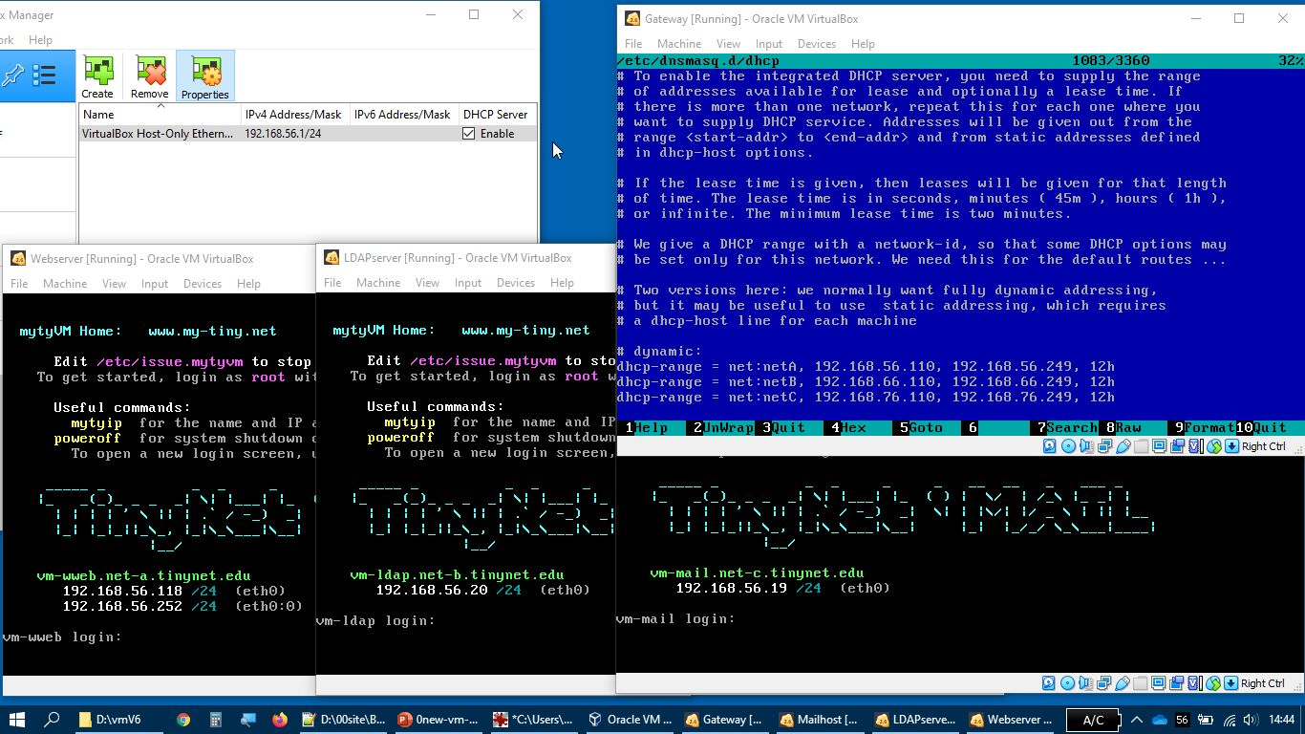


/etc/dnsmasq.d/dhcp
net-a: ..56.+
net-b: ..66.+
net-c: ..76.+
Virtualbox DHCP subverts our subnets!
If Virtualbox DHCP is ON, the Mailserver and LDAPserver get a Net-A address
All of the configurations assume they have an IP address on their proper subnet,
So nothing will work properly!

Slide 15
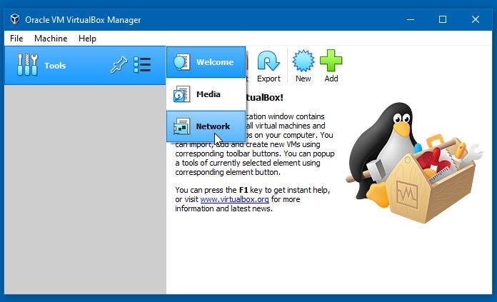
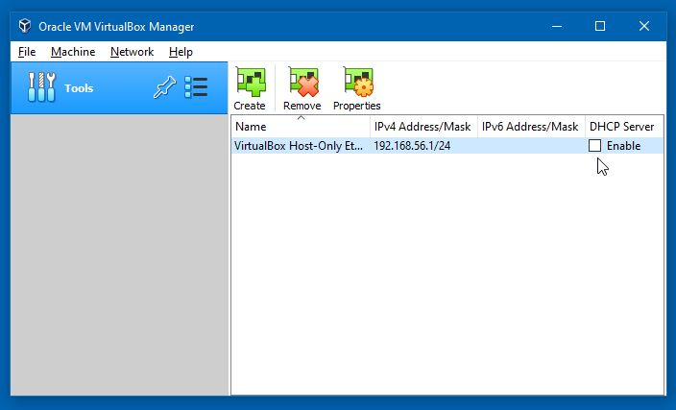
The First Thing to take care of is to Turn Off the VirtualBox internal DHCP server

Slide 16
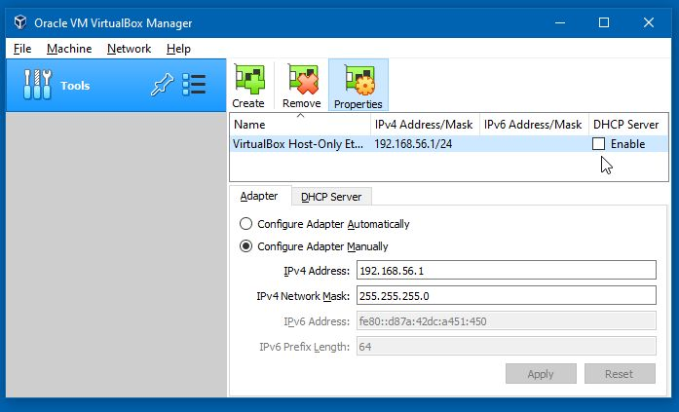
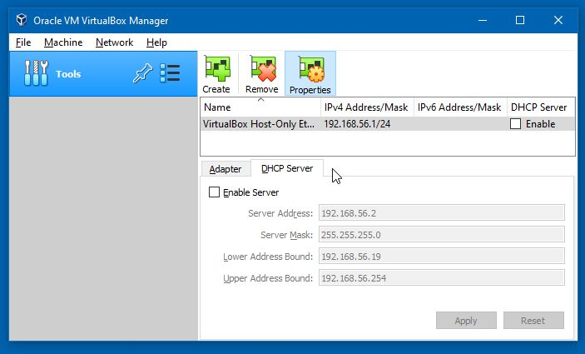
The Next Thing is to Check the IP Address is 192.168.56.1

Slide 18
TCP Config c:\windows\system32\drivers\etc
c:\windows\system32\drivers\etc\hosts
we can edit this file to add a new name for the local IP address 127.0.0.1 or any address on the same subnet
requires an editor (notepad) running with elevated privileges
This is not required – or even recommended
(still needs some testing to find out what problems might come along when TinyNet VMs are not running)
But it is interesting – try it if you like!

Slide 19
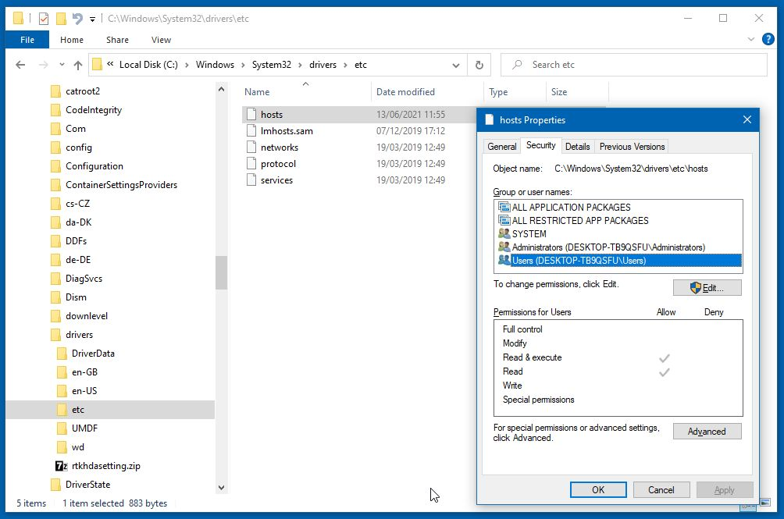
TCP Config c:\windows\system32\drivers\etc

Slide 20
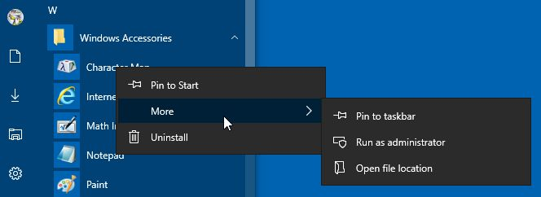
Notepad Run as Administrator
Find Notepad under Windows Accessories on the Start Menu
Right Click it, select More, and Run as Administrator

Slide 21
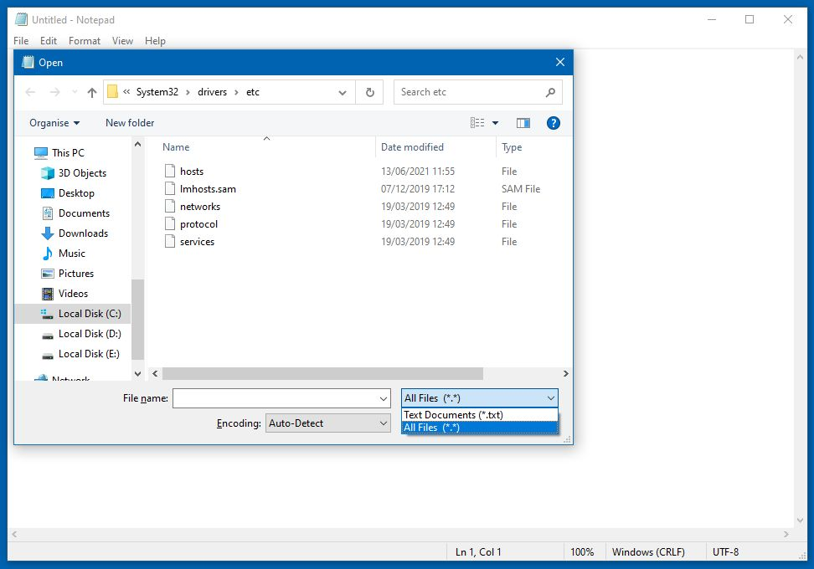
Notepad Run as Administrator
File > Open
will be blank until the filename filter is changed

Slide 22
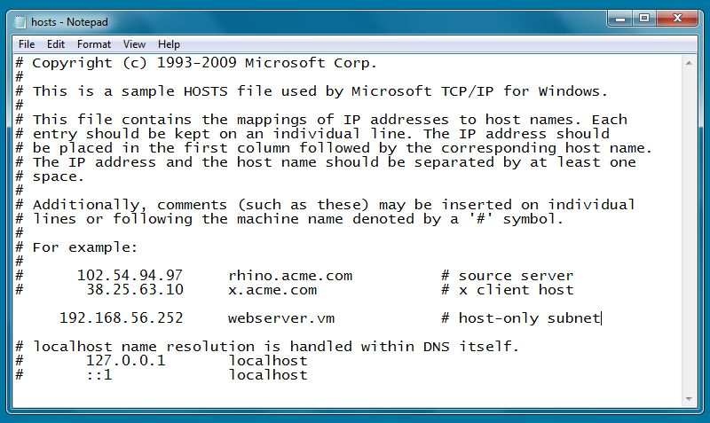
New name mapping: Edit and Save the file

Slide 23
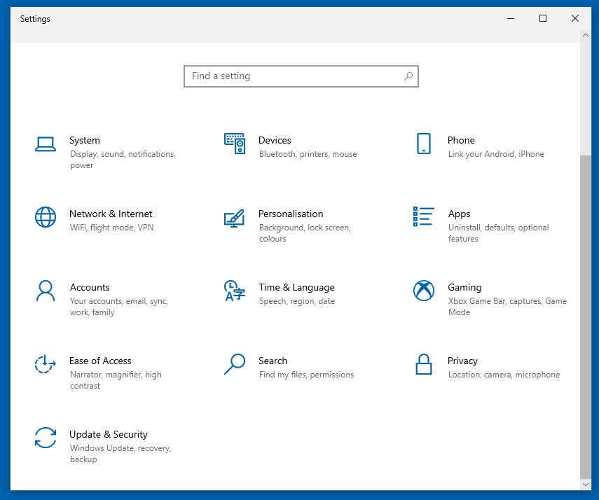
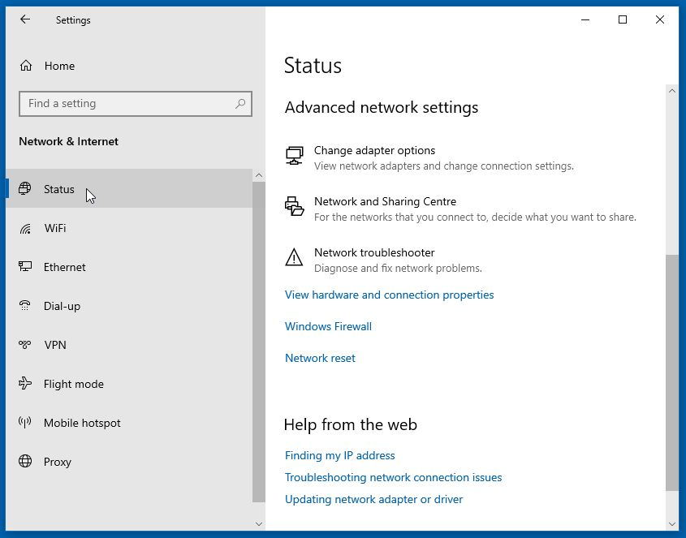
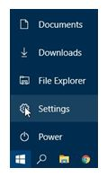
Network Interface in Windows
2
3
1
Connect to TinyNet DNS
(Requires Administrator Privileges)

Slide 24
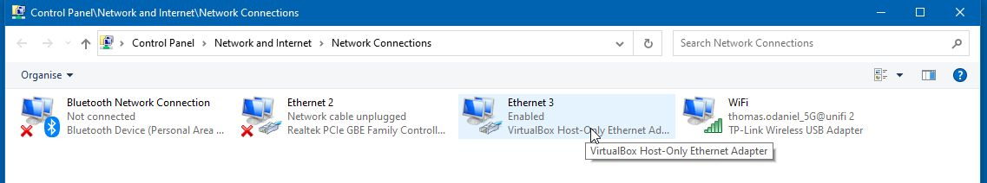
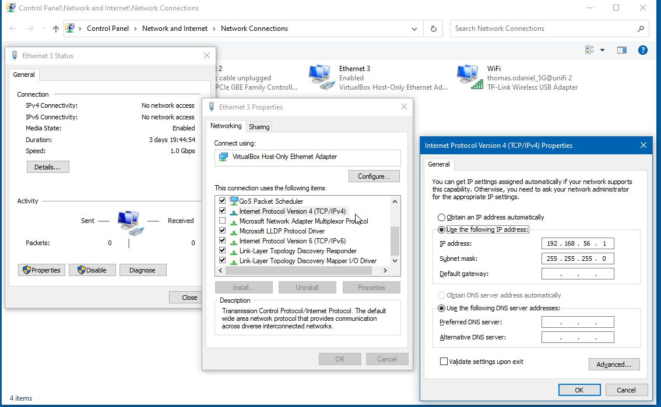
1
3
2
192.168.56.101
Fill in
Gateway net-a interface
192.168.56.101

